Slide 1


Department of Information Technology
Early detection of Parkinson’s Disease using Random Forest Algorithm
Academic Year : 2023 - 24
Under the guidance of:
Mr. D. S. Srinivas
Assistant Professor
Department of IT
Batch - 14
20HP1A1201 : A. Akhila
20HP1A1216 : B. Madhuri
20HP1A1222 : Sk. Rahamathunnisa

Slide 2
Contents
01
05
09
Abstract
Proposed System
Implementation
02
06
10
Literature survey
System Requirements
Conclusion
03
07
Problem Statement
Data Acquisition
11
Future Scope
04
08
Design Modelling
12
References
Existing System
Parkinson’s disease
Batch-14
Batch-14
2
A.Y : 2023 - 24
1
Department of IT
1
Batch -14
PD Detection
1201, 16, 22

Slide 3
Abstract
The Parkinson’s Disease (PD) is an age-related neurological disorder. When people reach over the age of 50, they face challenges which affects the motor functions of the body such as shaking of the body, hands and provides stiffness to the body. Besides, all PD patients’ symptoms are neither the same nor they all become pronounced at the same stage of the illness. Even though there is no cure for this Parkinson’s disease but controlled through early detection, thus enabling patients to lead a normal life without complications, which will also reduce the cost of the disease. Because late detection leads to no treatment and loss of life. Unfortunately, due to insufficient resources and awareness, proper and timely PD detection is highly challenged. In our project we aim to detect PD early, remotely, and accurately using different Machine Learning Models such as Support Vector Machine (SVM) and Random Forest (RF). Therefore, this work aims to combine more than one symptom by collecting data and detect PD with the help of a machine learning system. The data are primarily collected from diagnosed PD patients and healthy people for building and optimizing machine learning models that exhibit higher performance.
Keywords: Parkinson’s disease, Random Forest Algorithm, Support Vector Machine Algorithm
Parkinson’s disease
Batch-14
Batch-14
2
A.Y : 2023 - 24
2
Department of IT
PD Detection
1
Batch -14
PD Detection
1201, 16, 22

Slide 4
Literature survey
S. No | Title | Authors | Algorithms | Justification
1. | Collection and Analysis of a Parkinson Speech Dataset with Multiple Types of Sound Recordings | Betul Erdogdu Sakur, M. Erdem Isenkul, C. Okan Sakar, Ahmet Serthas, Fikret Gurgen, Sakir Delil, Hulya Apaydin. and Olcay Kursun | K-Nearest Neighbors (KNN), Support Vector Machine (SVM) | S-loso validation outperformed loo in classifying Parkinson's disease from voice samples achieving KNN accuracy.
2. | Detection of Parkinson’s Disease from vocal features using Random Subspace classifier ensemble | Ömer ESKØDERE, Ali KARATUTLU, Cevat ÜNAL | K-Nearest Neighbors (KNN), Linear Discriminant Analysis (LDA), and Quadratic Discriminant Analysis | Utilized a random subspace ensemble method with KNN to improve classifier performance on showcasing KNN's superiority over LDA % QDA.
3. | An LSTM based DL model for voice-based detection of Parkinson’s disease | Danish Raza Rizvil, Iqra Nissar, Sarfaraz Masood, Mumtaz Ahmed, Faiyaz Ahmad | Deep Neural Networks (DNN) and Long Short-Term Memory (LSTM) | Employed DNN and LSTM networks to detect and predict disease using voice samples, achieving superior performance.
4. | Diagnosis of the Parkinson Disease by using DNN Classifier | Abdullah CALISKAN, Hasan BADEM, Alper BAŞTÜRK Mehmet Emin YÜKSEL | Deep Neural Networks (DNN) with stacked autoencoders and SoftMax classifier for prediction | Employed DNN with stacked autoencoders and SoftMax classifier for prediction on datasets for superior performance over old methods.
5. | Classifying Parkinson Disease based on acoustic measures using ANN | Lucijano Berus. Simon Klancnik, Miran Brezocnik and Mirko Ficko | ANNs on dataset using the LOSO scheme, incorporating feature selection based on correlation coefficients | Utilized multiple ANNs with feature selection to predict disease and got 86.47% test accuracy and suggested improvements in feature selection.
Parkinson’s disease
Batch-14
Batch-14
2
A.Y : 2023 - 24
3
Department of IT
1
Batch -14
PD Detection
1201, 16, 22

Slide 5
Problem Statement
Parkinson’s disease (PD) affects muscle movement in the body due to a deficiency in dopamine-producing neurons in the brain.
Motor symptoms include posture instability, rigidity, tremors, and slowness of movement and Non-motor symptoms include depression, anxiety, and sleep disturbances.
New, less expensive, and simplified diagnostic techniques are needed.
While there's no cure, treatments like medications and surgery can manage symptoms and improve quality of life.
Machine learning Techniques - Support Vector Machine (SVM) and Random Forest (RF).
Parkinson’s disease
Batch-14
Batch-14
2
A.Y : 2023 - 24
4
Department of IT
1
Batch -14
PD Detection
1201, 16, 22

Slide 6
Parkinson’s disease (PD) is incurable, but early prediction can reduce complications and control symptoms.
Currently, people must physically consult a doctor to determine if they have Parkinson’s Disease.
Lack of precise prediction means PD may only be detected when it becomes severe, requiring costly interventions.
Individuals often have limited knowledge to evaluate their medical reports.
Conventional strategies may lead to delayed detections and severe consequences.
There's a need for detection mechanisms in symptom-free stages, especially in Machine Learning.
Existing System
Parkinson’s disease
Batch-14
Batch-14
2
A.Y : 2023 - 24
5
Department of IT
1
Batch -14
PD Detection
1201, 16, 22

Slide 7
1
1
Late Detection
2
Costly Procedures
Disadvantages
of Existing System
3
Dependency on Physical Symptoms
4
Lack of User Accessibility
Parkinson’s disease
Batch-14
Batch-14
2
A.Y : 2023 - 24
6
Department of IT
1
Batch -14
PD Detection
1201, 16, 22

Slide 8
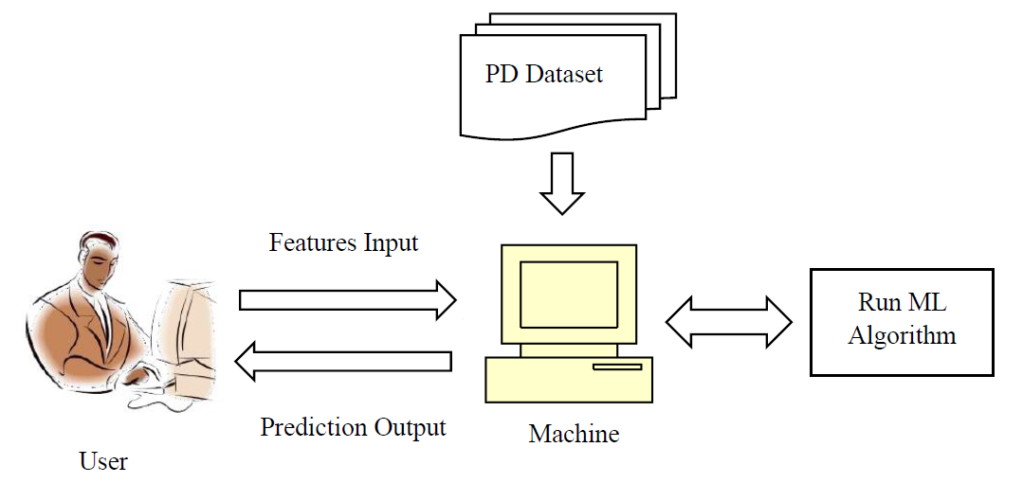
The project offers a user-friendly web interface for input and output interactions to ensure accessibility and ease of use
The algorithm selection, whether SVM or RF, was based on the results obtained from the evaluation process
One of the popular Machine Learning libraries like sklearn was used in the project from which Random Forest Classifier was imported
Users have the option to manually check for the presence of disease in their body
Web interface was designed to be user-friendly
Proposed System
Parkinson’s disease
Batch-14
Batch-14
2
A.Y : 2023 - 24
7
Department of IT
1
Batch -14
PD Detection
1201, 16, 22

Slide 9
1
Early Detection
2
Cost Effectiveness
Advantages
of Proposed System
3
Global Reach
4
User-Friendly Web Interface
Parkinson’s disease
Batch-14
Batch-14
2
A.Y : 2023 - 24
8
Department of IT
1
Batch -14
PD Detection
1201, 16, 22

Slide 10
Software requirements
Hardware requirements
IDE : Visual Studio Code
Operating system : Windows 11
Programming Language : Python 3
Processor : Intel i5
RAM : 8GB
Hard Disk : 512GB
Parkinson’s disease
Batch-14
Batch-14
2
A.Y : 2023 - 24
9
Department of IT
1
Batch -14
PD Detection
1201, 16, 22

Slide 11
Dataset Acquisition
The dataset source was obtained from Kaggle website
https://www.kaggle.com/datasets/vikasukani/parkinsons-disease-data-set
To develop the project, 195 records with 24 features were extracted from the extensive dataset available.
Parkinson’s disease
Batch-14
Batch-14
2
A.Y : 2023 - 24
10
Department of IT
1
Batch -14
PD Detection
1201, 16, 22

Slide 12
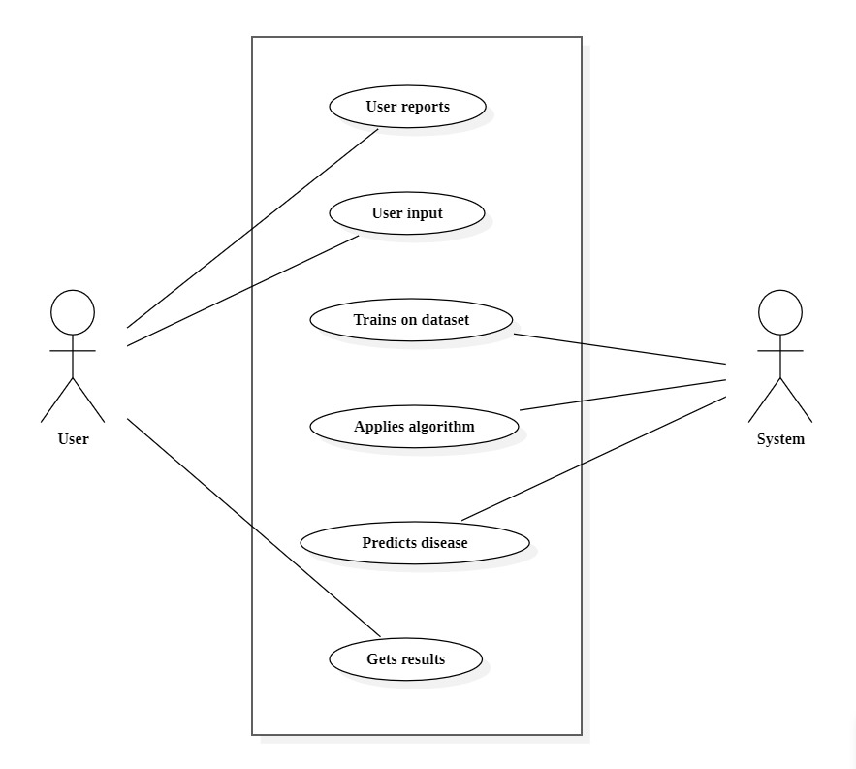
UML Diagrams for PDD
Usecase diagram for PDD :
Parkinson’s disease
Batch-14
Batch-14
2
A.Y : 2023 - 24
11
Department of IT
1
Batch -14
PD Detection
1201, 16, 22

Slide 13
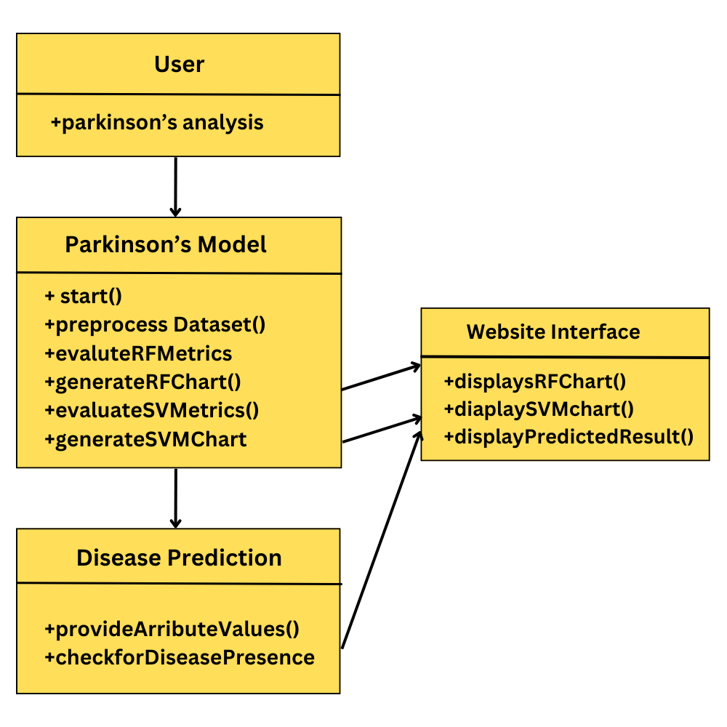
Class diagram for PDD :
Parkinson’s disease
Batch-14
Batch-14
2
A.Y : 2023 - 24
12
Department of IT
1
Batch -14
PD Detection
1201, 16, 22

Slide 14
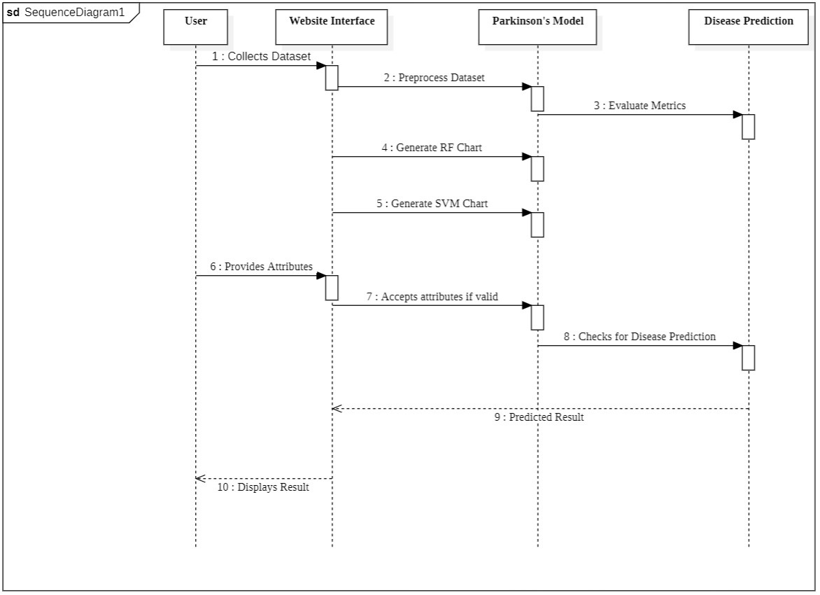
Sequence diagram for PDD:
Parkinson’s disease
Batch-14
Batch-14
2
A.Y : 2023 - 24
13
Department of IT
1
Batch -14
PD Detection
1201, 16, 22

Slide 15
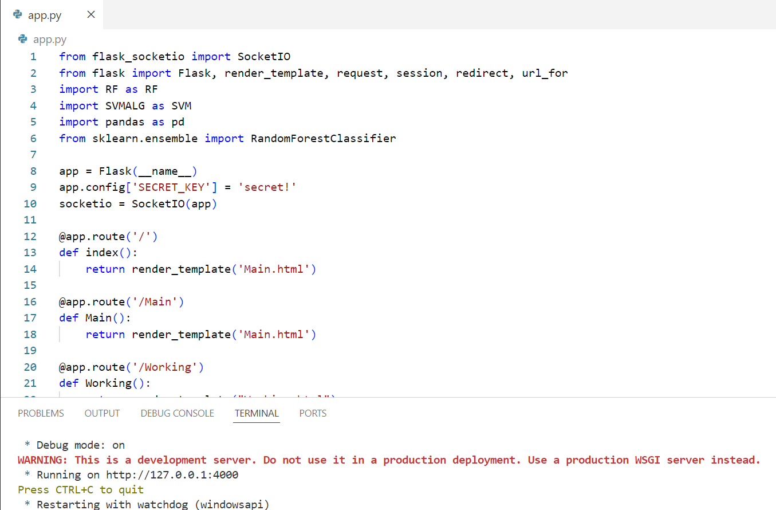
Implementation :
Parkinson’s disease
Batch-14
Batch-14
2
A.Y : 2023 - 24
14
Department of IT
1
Batch -14
PD Detection
1201, 16, 22

Slide 16
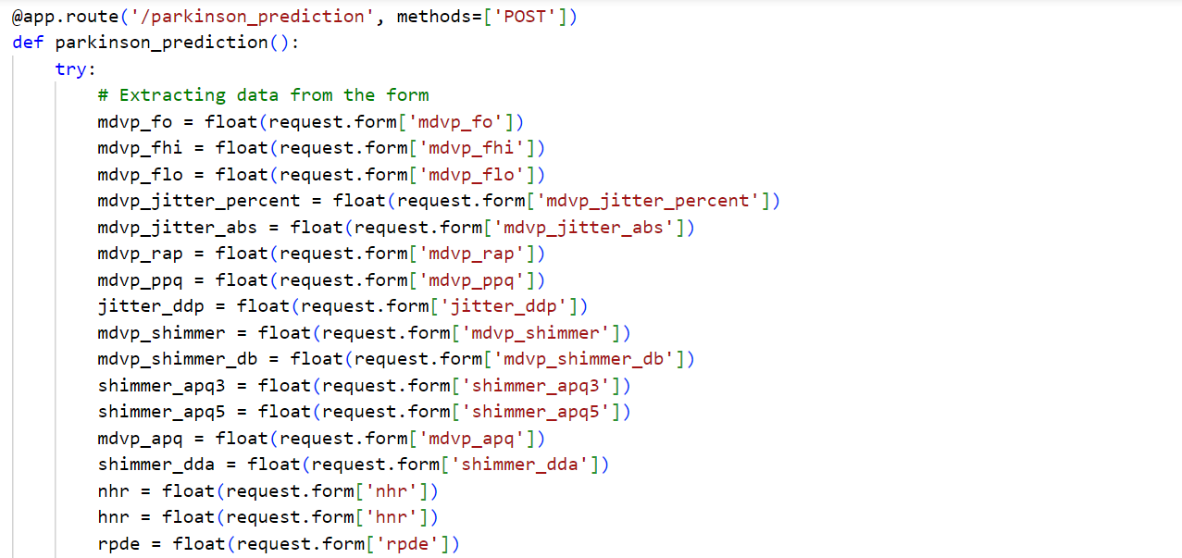
Parkinson’s disease
Batch-14
Batch-14
2
A.Y : 2023 - 24
15
Department of IT
1
Batch -14
PD Detection
1201, 16, 22

Slide 17

Home Page
Parkinson’s disease
Batch-14
Batch-14
2
A.Y : 2023 - 24
16
Department of IT
1
Batch -14
PD Detection
1201, 16, 22

Slide 18

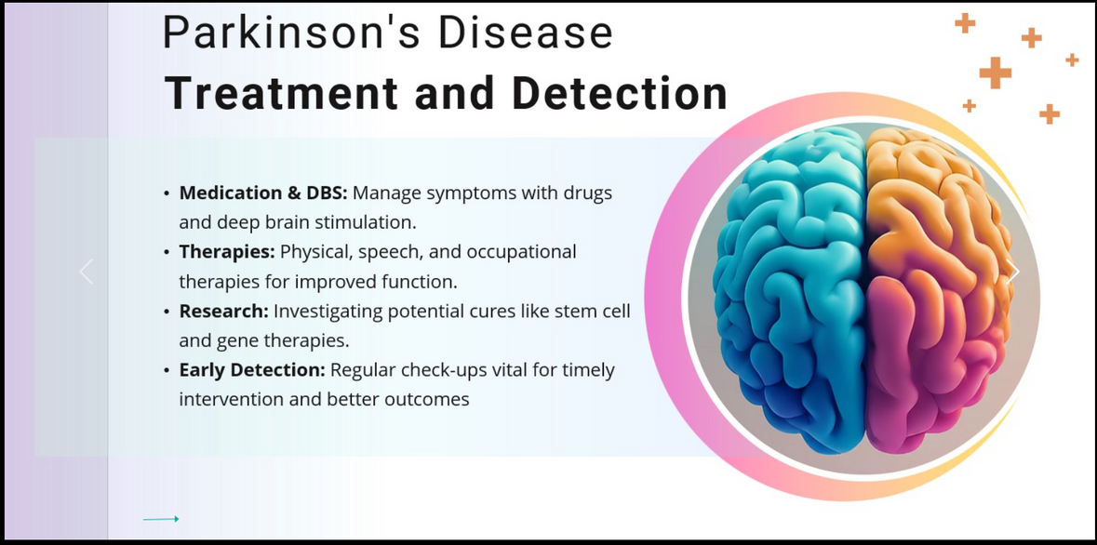


Web Interface
Parkinson’s disease
Batch-14
Batch-14
2
A.Y : 2023 - 24
17
Department of IT
1
Batch -14
PD Detection
1201, 16, 22

Slide 19
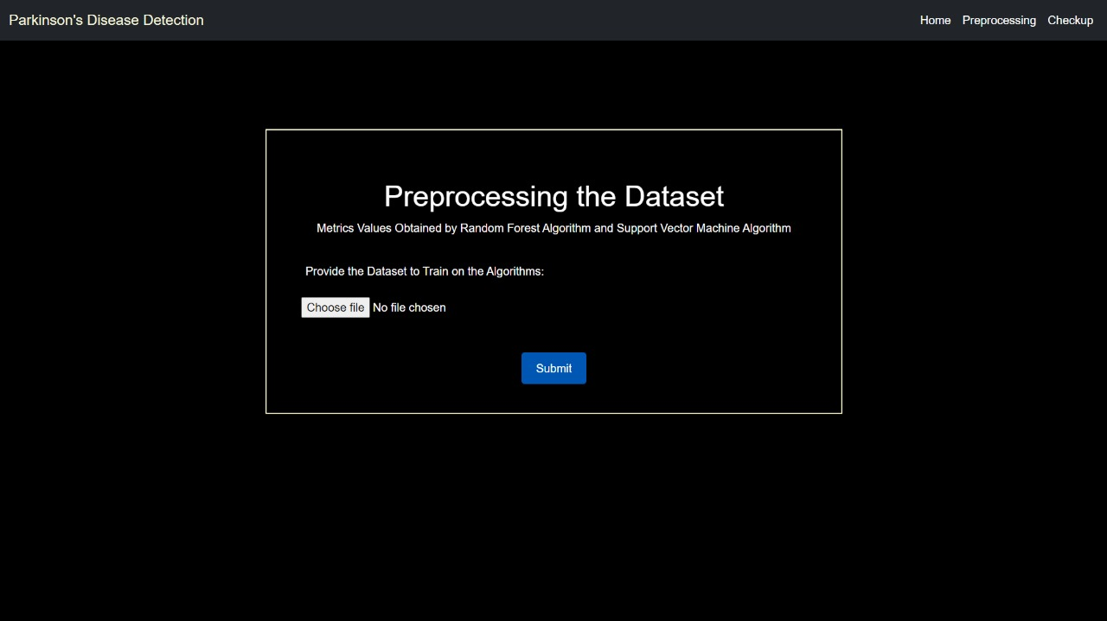
Data Preprocessing Interface
Parkinson’s disease
Batch-14
Batch-14
2
A.Y : 2023 - 24
18
Department of IT
1
Batch -14
PD Detection
1201, 16, 22

Slide 20
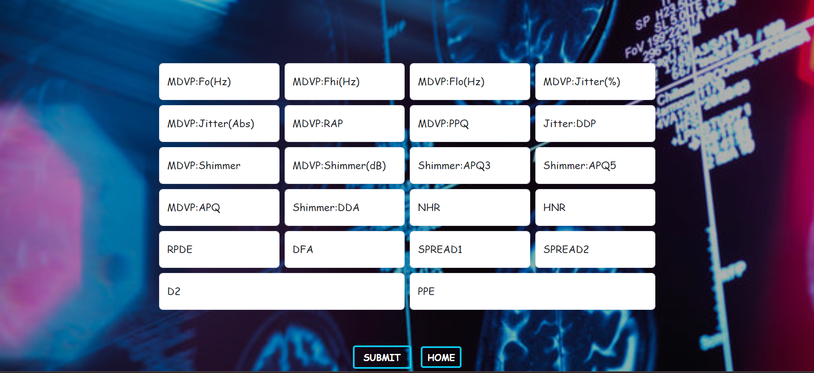
Check Up :
Parkinson’s disease
Batch-14
Batch-14
2
A.Y : 2023 - 24
19
Department of IT
1
Batch -14
PD Detection
1201, 16, 22

Slide 21

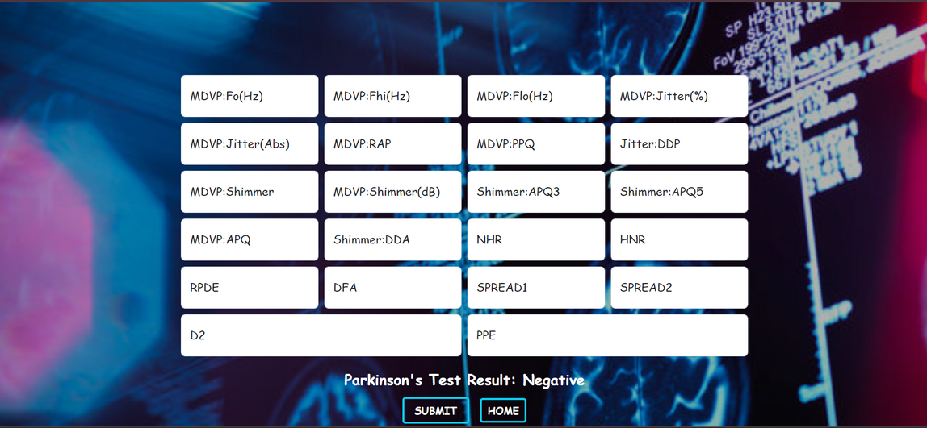
Example for Negative Result :
Parkinson’s disease
Batch-14
Batch-14
2
A.Y : 2023 - 24
20
Department of IT
1
Batch -14
PD Detection
1201, 16, 22

Slide 22
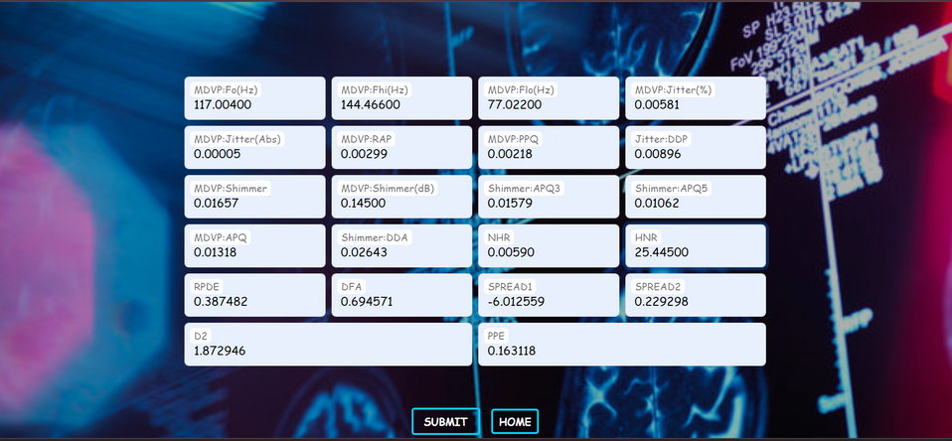

Example for Positive Result :
Parkinson’s disease
Batch-14
Batch-14
2
A.Y : 2023 - 24
21
Department of IT
1
Batch -14
PD Detection
1201, 16, 22

Slide 23
Conclusion
The proposed work is the prediction of Parkinson’s disease using machine learning algorithm to predict PD at an early stage. The dataset shows input parameters collected from the PD patients and the models are trained and validated for the given input parameters. Random forest, and Support Vector Machine learning are constructed to carry out the diagnosis of PD. The performance of the models are evaluated based on the accuracy of prediction. The results of the research showed that Random forest Classifier showed better predicts PD in comparison to Support Vector machines.
Parkinson’s disease
Batch-14
Batch-14
2
A.Y : 2023 - 24
22
Department of IT
1
Batch -14
PD Detection
1201, 16, 22

Slide 24
Future Scope
Develop smart phone apps for continuous symptom monitoring.
Integrating with other related predictive models with clinical decision support system can enhance the accuracy.
Promotes worldwide adoption and adaptation of predictive model.
Through slight enhancements, doctors can utilize it for disease prediction.
Parkinson’s disease
Batch-14
Batch-14
2
A.Y : 2023 - 24
23
Department of IT
1
Batch -14
PD Detection
1201, 16, 22

Slide 25
References
[1] DOI: 10.1109/ITNEC52019.2021.9586915, Document Type: Conference Paper Volume, Editors: Xu B. Mou, K. , Publisher: Institute of Electrical and Electronics Engineers Inc.
Available : https://www.scopus.com/record/display.uri?eid=2-s2.0-85119293214&origin=inward&txGid=e2f265f8805d8d7ef53363214c2c7197
[2] Parkinson's Foundation. Parkinson's Disease; 2021.
Available: https://www.parkinson.org/Understanding-Parkinsons/What-is-Parkinsons
[3] Published in: 2018 IEEE Signal Processing in Medicine and Biology Symposium (SPMB), Date of Conference: 01-01 December 2018, Date Added to IEEE Xplore: 17 January 2019, DOI: 10.1109/SPMB.2018.8615607, Publisher: IEEE
Available : https://ieeexplore.ieee.org/document/8615607
[4] Early Detection of Parkinson’s Disease Using Deep Learning and Machine Learning WU WANG, JUNHO LEE, FOUZI HARROU, (Member, IEEE), and YING SUN, 2020 (IEEE).
[5] The article "Early Parkinson's Disease Detection Using Machine Learning Approach" by Abiona Akeem Adekunle et al. proposes a method for early detection of Parkinson's disease using machine learning techniques. The study, conducted collaboratively by authors from Federal Polytechnic Ile-Oluji and the University of Lagos, Nigeria, presents a significant advancement in leveraging computational methods for healthcare. DOI:10.9734/AJRCOS/2023/v16i2337.
[6] https://www.youtube.com/watch?v=HbyN_eyJVc&list=PLfFghEzKVmjuhQwKhYXvdU94GSU-6Jcjr&index=6 – YouTube Reference Link
Parkinson’s disease
Batch-14
Batch-14
2
A.Y : 2023 - 24
24
Department of IT
1
Batch -14
PD Detection
1201, 16, 22

Slide 26

THANK YOU
Parkinson’s disease
Batch-14
Batch-14
2
A.Y : 2023 - 24
PD Detection
Department of IT
1
Batch -14
1201, 16, 22

